Slide 1
Group BETA
Project Name : Mp3 Player
Md Zahirul Haque – F16040103
Ruhel Ahmed Raktim –F16040120
Sarfaraz Rahman –F16040116
Mamun Ali –F16040106
Danil Orichshenko –F16040123

Slide 2
Description
This music player app for Android Devices had the following goals:
The app will present a list of songs on the user device, so that the user can select songs to play.
The app will also present controls for interacting with playback and will continue playing when the user moves away from the app.
The most important goal of this app is simplicity.
We’ve used the android platform that provides resources for handling media playback to create an interface between the user and their music files.

Slide 3
The user interface of this app is pretty simple and clean.
Open the app and it will present the list of all the songs on your device. Select the song ,tap on it, and it will start playing the selected song.

Slide 4
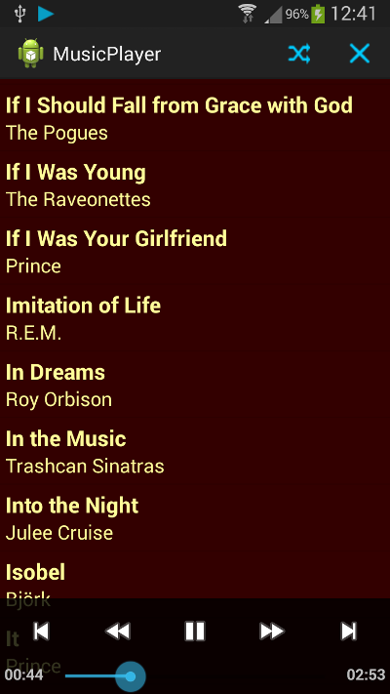

Slide 5
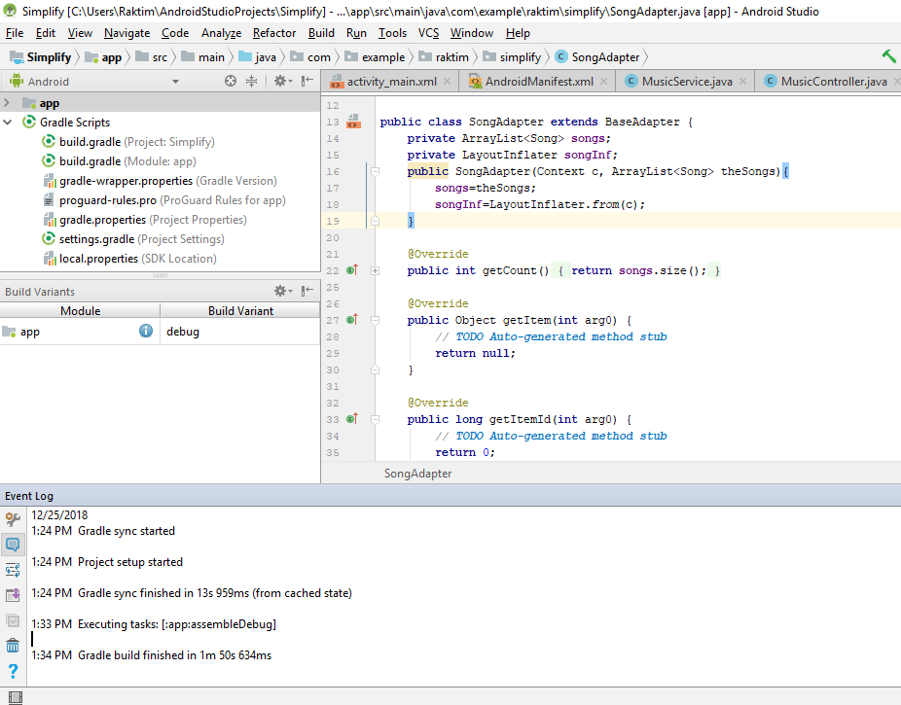
Successfully Build with no errors

Slide 6
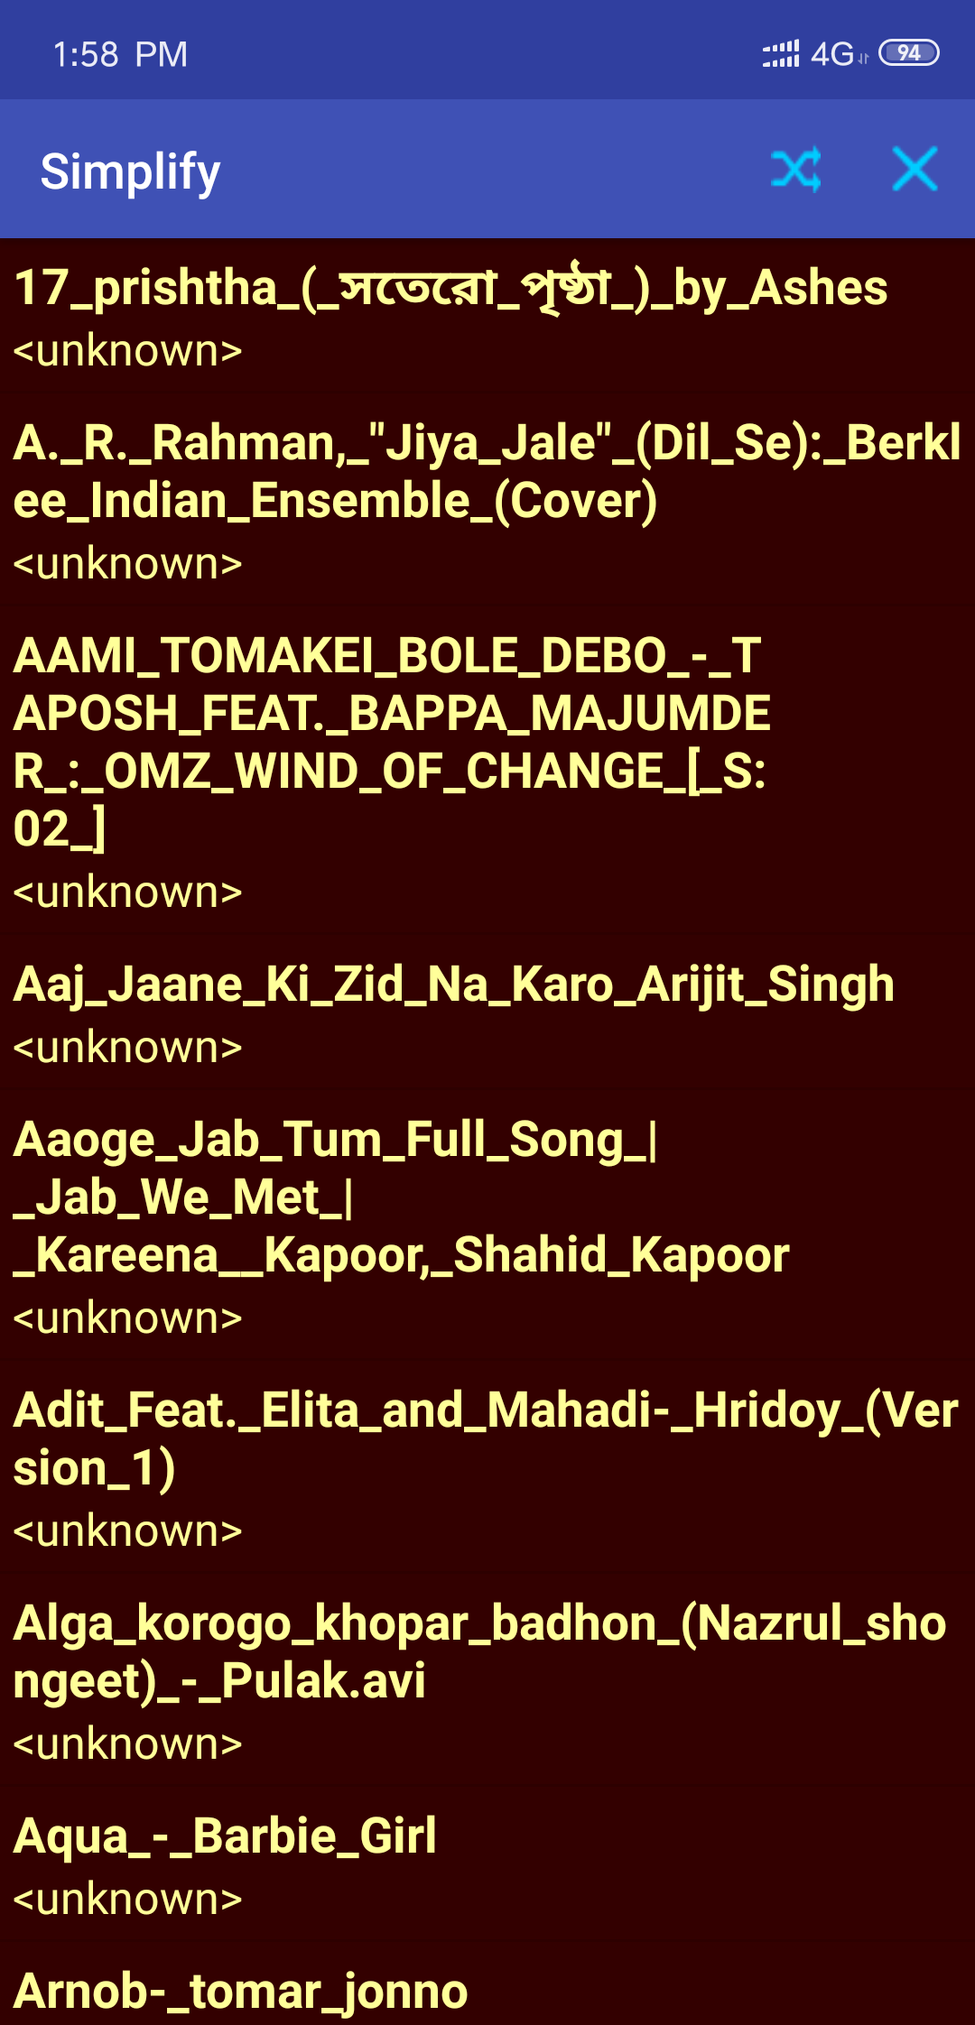
The final version of the application tested on a user device

Slide 7
Conclusion
That’s a very simple to use music player app for android. Improvements or enhancement that can be made:
adding support for streaming media, video, audio focus, and providing different methods to interact with the music tracks on the device.
extend the app to build additional functionality or to improve reliability on different devices.
Find our app here: https://github.com/njuptcourses/project-2018-autumn-beta

